Slide 1
Secure Application Development with IS-3
Christopher Thielen
Enterprise Applications Supervisor, IET EIS

Slide 2
Disclaimer
This presentation represents the presenter's reading of the Secure Software Development Standard as published 3/12/2018.
This presentation is not to be interpreted as an official guide nor set of recommendations.
Please refer to the document “University of California – Policy BFB-IS-3” for policy text and direct inquiries through the appropriate channel.

Slide 3
The Nature of Application Security
Productivity and security are seen as competing forces.
Vendor samples are designed to get you started quickly. Security is often an extra step.
But security is a requirement from stakeholders and the University of California.
How do we treat security?
Is security a product feature?
Is security an architectural concern?
Is security a development practice?
Inverted design thinking: security requires consideration of byproduct capabilities – that which your application can do that you never intended.

Slide 4
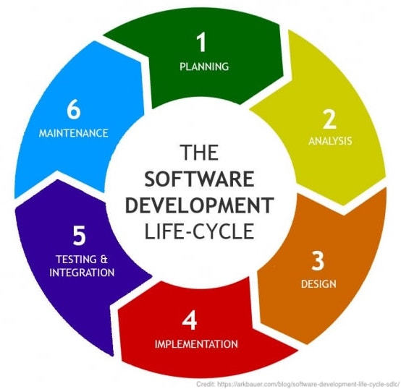
Software Development Lifecycle
The Software Development Lifecycle (SDLC) is a framework to describe software development. You adhere to the SDLC whether you realize it or not as every step must be completed, even if implicitly.
Secure thinking can be integrated at every step:
Planning (what are we thinking of doing?): What information will we be storing? Who should have access?
Analysis (what specifically will we build?): What risks exist based on the requirements?
Design (what is our technical architecture?): How secure is our architecture?
Implementation (coding)
Testing & Integration: Test your security. Automate common penetration tests.
Maintenance: Patches, bug fixes, adherence to future standards

Slide 5
Key Concept Protection and Availability Levels
Image credit: Christoph Scholz (CC BY-SA 2.0)

Slide 6
Protection and Availability Levels
Protection Levels and Availability Levels classify services based on severity.
PL and AL thresholds may dictate which policy items to follow, i.e. public data may be treated differently than highly sensitive, proprietary data.
Protection is concerned with data privacy and integrity.
Compromised data may violate privacy, expose intellectual property, and more.
Availability is concerned with service efficiency and disruption.
Service disruptions are expensive.

Slide 7
Protection Levels
P1 (Minimal, Public): Information readily available to the public. Primary concern is unauthorized modification.
P2 (Low, Internal): Information not intended for public use, but not covered by statue, regulations, etc. Compromise may result in minor damage, small financial loss, or have minor privacy impacts.
P3 (Moderate, Proprietary): Compromise may result in moderate fines, civil actions. Privacy violations are moderate, financial loss is moderate, legal action may result. This includes lower risk items that, when combined, represent increased risk.
P4 (High, Statutory): Significant harm in all forms, including reputation. May include civil or criminal violations.

Slide 8
Availability Levels
A1 (Minimal): Minimal impact or minor financial loss.
A2 (Low): Minor losses or inefficiencies.
A3 (Moderate): Moderate financial losses and/or reduced customer service.
A4 (High): Significant financial loss, major impairment of the Location. IT Resources required by statutory, regulatory, or legal obligations are major drivers for this risk level.

Slide 9
Requirements For Secure Software Development
Image credit: Yuri Samoilov (CC BY 2.0)

Slide 10
Secure Software Requirements
Software Development Process
Input Validation
Exception and Error Handling
Cross Site Scripting (XSS) and Invalidated Redirects/Forwards
Insecure Direct Object References
Logging
TLS and Secure APIs
Credentials/Passphrases
Session and Logout
Federated Authentication/SAML/Shibboleth
File Management
Secure Configuration
Documentation
Version Control
What follows are highlighted items from each section, not the entirety of the section itself.

Slide 11
Software Development Process
Change Management
For smaller teams, talk to someone besides yourself to ensure you haven’t forgotten any details about a change you’re about to make.
Requirements for P3 or higher, A3 or higher:
Code reviews which include cyber-security risks
Check for common security mistakes
Reviews should be performed by a senior developer, or preferably an independent one
Use automated tools for static and dynamic analysis
Requirement 1 of 14

Slide 12
Input Validation
Validate all input (data type, string length, foreign key existence – assume you’ll receive anything and everything)
Expect GET parameters and form elements to be manipulated in ways Javascript or browsers cannot protect against
Use parameterized SQL statements or equivalents
Set autocomplete=off to prevent caching of sensitive information
URL/URI must never include:
Credentials
Access tokens, serial numbers, record numbers
PII (names, SSNs, birthdates)
PHI (Medical Record Number, diagnosis, condition)
Requirement 2 of 14

Slide 13
Exception and Error Handling
Do not reveal native frameworks
Set up custom error pages
Ensure all errors and exceptions provide users/administrative staff enough information to diagnose the issue
Never use empty catch blocks
Log all exceptions and errors
Requirement 3 of 14

Slide 14
Cross Site Scripting (XSS) and Invalidated Redirects/Forwards
Do not send untrusted data data or code to the browser.
Test for common XSS attacks
https://github.com/OWASP/CheatSheetSeries/blob/master/cheatsheets/Cross_Site_Scripting_Prevention_Cheat_Sheet.md
Requirement 4 of 14

Slide 15
Insecure Direct Object References
Use access control checks for any object, file, database key, etc.
Requirement 5 of 14

Slide 16
Logging
Log:
Authentication success/failure
Use of privileged functions
Administrative activities
System start/stop
Log security-related events to a separate log file, if possible
Do not log sensitive information
Use log file naming conventions (rotation, location)
Monitor your log files in a central location
Ensure sufficient space is available for logs
Requirement 6 of 14

Slide 17
TLS and Secure APIs
Force HTTPS and disable HTTP
Use TLS 1.2 or later for machine-to-machine connections (including database connection)
Encrypt and authenticate APIs, extract tools, service busses
Separate public and private application APIs
Configure CORS to restrict invocation rights
Requirement 7 of 14

Slide 18
Credentials/Passphrases
Never store user passphrases
Never hardcode credentials
Protect service accounts with established tools and techniques
Implement lockout after 5 failed authentication attempts
Use secure protocols for credential/secrets exchange
Requirement 8 of 14

Slide 19
Session and Logout
Ensure session timeout is implemented
Make sure session tokens are random and long
Change session tokens at each logon and privilege escalation
Delete, remove, and invalidate tokens on logout
Provide a logout function, prominently displayed throughout the application
Properly close records, delete temporary objects, and close operations on the server:
As part of logout
After a set period of inactivity
After a browser window close
Requirement 9 of 14

Slide 20
Federated Authentication
Only use approved SSO providers
Assign permissions to user groups, not individual users
Assign users to user groups
Ensure a user group with no/minimal privileges exists
Assign new users to this group and make privilege escalation explicit
Log all actions that grant users or groups permissions
Re-check authorization at every request
Requirement 10 of 14

Slide 21
File Management
Prevent/disable directory traversal/directory listing
Filter web requests to block access to files with non-approved extensions (e.g. .dll, .config, .java, .cs, etc.)
For AL3 or higher, set a directory quota or similar control
Ensure shared volumes/file shares have appropriate access restrictions limited to the application service account
Requirement 11 of 14

Slide 22
Secure Configuration
Use secure configuration libraries, tools
Perform vulnerability scans
Run components with the least privileges possible
Execute SQL with the least privilege possible
Define, implement, and maintain secure settings (i.e. do not rely on default settings)
Secure the configuration used by the application
Set Header and Content-Security-Policy when possible (helps protect against XSS)
Requirement 12 of 14

Slide 23
Documentation
(Applies to P3/A3 or higher)
Record the steps taken to protect confidentiality concerns, integrity concerns, availability concerns
Track defects and fixes to defects
Note/record testing processes and how testing processes mitigate cyber risk
List components used and the security state of the components
Requirement 13 of 14

Slide 24
Version Control
(Applies to P3/A3 or higher)
Use a software version control system or repository
Deploy test and production applications from the version control system or repository
Tag/label versions so they can be extracted at a later time
Configure version control to prevent/detect unauthorized changes
Requirement 14 of 14

Slide 25
References
IS-3: https://policy.ucop.edu/doc/7000543/BFB-IS-3
IS-3 Secure Software Development Standard: https://security.ucop.edu/files/documents/guides/secure-software-development-standard.pdf
UC Davis IS-3 information page: https://iet.ucdavis.edu/learn-more

Slide 26
Thank you

