Slide 1
To the Cloud!
A Personal Journey

Slide 2
Server By Default
I installed Linux on my laptop and set up Apache, MySQL, PHP there, so when I had access to my first server, that’s what I did.
While Hand-Crafted Artisanal Servers (™) are great for learning, they don’t scale, and they soon annoy.
Recipes came on the scene and made things better. Now I could stamp out my Artisanal httpd.conf files quickly but they were still dependent on the server environment and didn’t match my dev environment, and it was all still a little annoying.

Slide 3
Let There Be Containers!
What the hell is a container?
Don’t swear.
Containers have been defined in a few ways — they’re really not complicated — but let me just say for this presentation, they’re a way to save the state of a server and spin it back up super quick, anywhere, sort of like cloning a VM only way, way, way lighter. They’re also nothing like VMs but I don’t have time for that.

Slide 4
Containers are like
git commit
for server setups.

Slide 5
Isn’t this presentation about the cloud?

Slide 6
What about the cloud?
First, you don’t need the cloud. You could run the Docker daemon on your Hand-Crafted Artisanal (™) server and life would still be a little better for you.
Clouds give me a few things:
Cheap, quick backups that I don’t have to think about.
Monitoring and alerts that I don’t have to think about.
The pointy-hairs know exactly what it costs to offer the service.
And most importantly of all, the platform vanishes entirely. I never have to run apt-get or dnf again.

Slide 7
I NEVER HAVE TO RUN apt-get AGAIN!!>!

Slide 8
But how?

Slide 10
This will be AWS specific but the concepts are useful.

Slide 11
We’re gonna need a few things …

Slide 12
Load Balancer

Slide 13
Image repository

Slide 14
Target group

Slide 15
Task definition

Slide 16
(Task definitions are immutable for some reason.)

Slide 17
Security group

Slide 18
CNAME records

Slide 19
Environment variable-based configuration

Slide 20
(Environment variable-based configuration may require some work)

Slide 21
Something called Fargate

Slide 23
(Whatever ‘elastic’ is referring to.)

Slide 24
Clusters

Slide 25
Services

Slide 26
CloudWatch

Slide 27
SNS

Slide 28
Health checks

Slide 29
(Health checks ironically take down my services on occasion.)

Slide 30
All delivered by an inconsistently-designed web interface that works okay.

Slide 31
Here’s how you container in AWS.

Slide 32
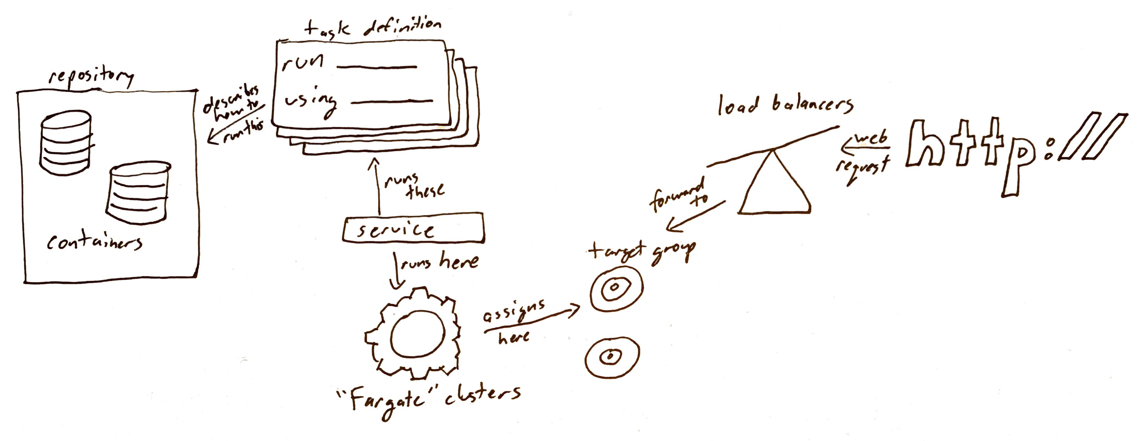

Slide 34
Repositories
Amazon ECR is a managed AWS Docker registry service. Customers can use the familiar Docker CLI to push, pull, and manage images.

Slide 35
Repositories
Amazon ECR is a managed AWS Docker registry service. Customers can use the familiar Docker CLI to push, pull, and manage images.
docker push [OPTIONS] NAME[:TAG]

Slide 36
Task Definitions
A task definition is required to run Docker containers in Amazon ECS. Some of the parameters you can specify in a task definition include:
The Docker image to use with each container in your task
How much CPU and memory to use with each task or each container within a task
The launch type to use, which determines the infrastructure on which your tasks are hosted
The Docker networking mode to use for the containers in your task
The logging configuration to use for your tasks
Whether the task should continue to run if the container finishes or fails
The command the container should run when it is started
Any data volumes that should be used with the containers in the task
The IAM role that your tasks should use

Slide 37
Task Definitions
A task definition is required to run Docker containers in Amazon ECS. Some of the parameters you can specify in a task definition include:
The Docker image to use with each container in your task
How much CPU and memory to use with each task or each container within a task
The launch type to use, which determines the infrastructure on which your tasks are hosted
The Docker networking mode to use for the containers in your task
The logging configuration to use for your tasks
Whether the task should continue to run if the container finishes or fails
The command the container should run when it is started
Any data volumes that should be used with the containers in the task
The IAM role that your tasks should use
docker run [OPTIONS] IMAGE[:TAG|@DIGEST] [COMMAND] [ARG...]

Slide 38
Services
Amazon ECS allows you to run and maintain a specified number of instances of a task definition simultaneously in an Amazon ECS cluster. This is called a service.

Slide 39
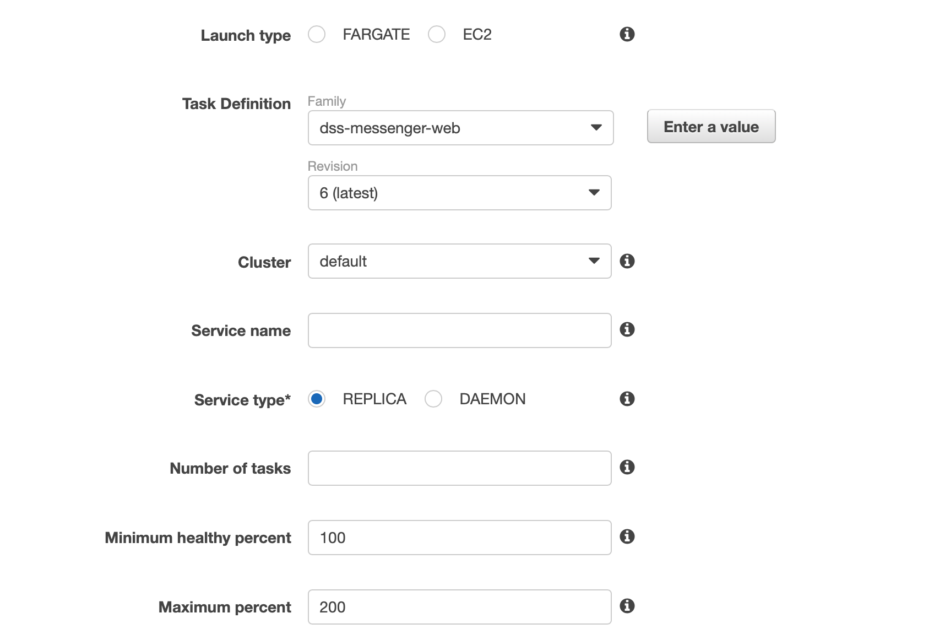
Services

Slide 42
Target Groups
Each target group is used to route requests to one or more registered targets. When you create each listener rule, you specify a target group and conditions. When a rule condition is met, traffic is forwarded to the corresponding target group

Slide 43
Target Groups
Mostly automatic when using the container service.

Slide 44
Load Balancers
Elastic Load Balancing automatically distributes incoming application traffic across multiple targets, such as Amazon EC2 instances, containers, IP addresses, and Lambda functions.

Slide 45
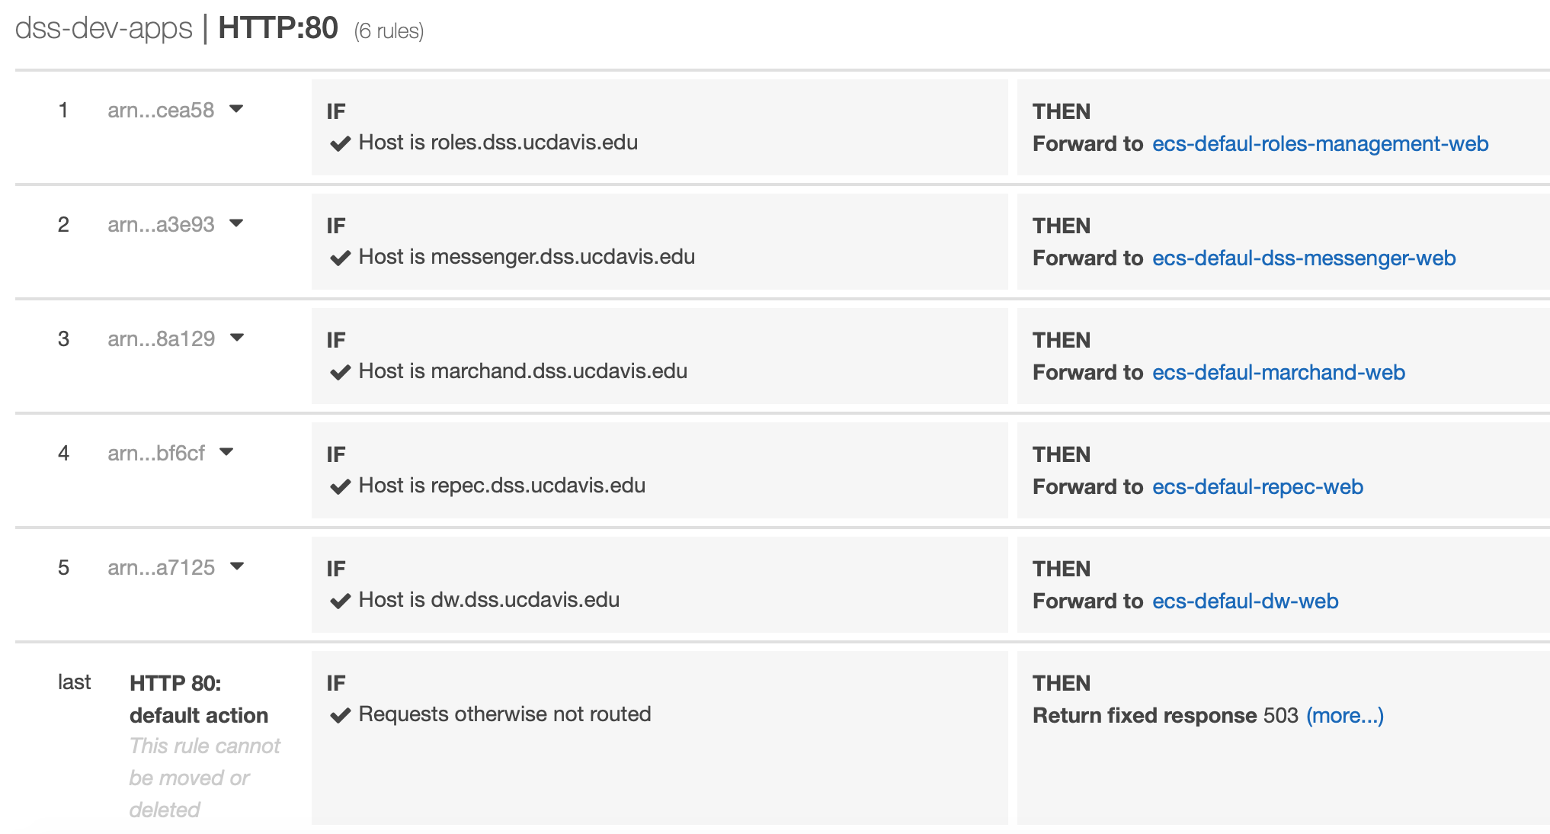
Load Balancers

Slide 46
Do I need a load balancer? I don’t get 1000 hits / s.

Slide 47
Sort of. You have options.

Slide 48
Handling Public Addresses
Load balancer (CNAME record + configure traffic router)
Elastic IP (very limited static IPs, presumably usable in ECS but double-check me)
Use the public IP already given to the running task (very dangerous, can change when task shuts down)
Don’t worry about it (background tasks don’t need public addresses but benefit from containerization)

Slide 49
WISDOM

Slide 51
Wisdom
Make sure your services are all running in the proper security group. This was my biggest headache and it does not reveal itself easily.
If your tasks appear to run but then shut down minutes later, make sure the health check isn’t killing them, e.g. checking on port 80 should return a HTTP 302 but the health check is configured to only accept HTTP 200.
You can use one application load balancer for many sites. This will save you $$$. I don’t know how I missed that.
Round-trip latency between AWS and campus is enough to kill performance if you need many requests / s, e.g. your application is running on campus but your RDB is on AWS. Just move it all to the same place. Bite the bullet.
Campus services (Banner!) are correctly firewalled. Take this into consideration. Moving to AWS means switching subnets. This may imply other changes.

Slide 52
What about CI? Or automated deploys using Terraform, etc.?

Slide 53
Ask me in a few months. I dunno.

Slide 54
CLI Workflow
$(aws ecr get-login --no-include-email --region us-west-2)
docker build -t the-image .
docker tag the-image:latest a.url.amazonaws.com/repo-name:latest
docker push a.url.amazonaws.com/repo-name:latest
aws ecs update-service —service service-name —force-new-deployment

Slide 55
Live demo?

