Slide 1
Angular 2 & Full Stack TypeScript
and introducing Docker on AWS

Slide 2
Graduate Studies Background
2012
Single monolithic ColdFusion website
Almost no client side JavaScript
MySQL and 2 Oracle DBs
Only prod environment
Campus Linux virtualization and other shared services
2015
Individual web apps running ColdFusion or Java + Spring
Drupal CMS
Client side JavaScript running either custom code, jQuery or Angular 1
MySQL and 3 Oracle DBs
local, test, CI and prod environments
Campus Linux virtualization and other shared services

Slide 3
Problem
Small IT team with limited resources
Too many programming languages
Too many server platforms
Too many databases
Unreliable or limited control over environment due to shared infrastructure

Slide 4
Goal: Simplify
Move infrastructure off of shared services
Move to a single server platform
Move to a single database type
Move to a single programming language
Break up monolithic web apps (not quite microservices but closer)

Slide 5
Solution (2016)
AWS
Self service server and data infrastructure
Automated server administration (patching, provisioning, ...)
ECS Container Service (Docker)
S3 object storage
JWT
Simpler API communication for Service Oriented Architecture
PostgreSQL
Cheaper
Easier to manage; we don’t even use most of the Oracle features
Full stack JavaScript (actually TypeScript)
Sharing code between client and server
Sharing code between projects
Simplified tooling
Single programming language to learn, update and master

Slide 6
Project: Programs Manager
Fairly simple CRUD web app for managing Graduate Program information like a detailed description, degrees offered, people, deadlines, bylaws, etc. Web app is mostly used as an API data end point for other applications like our public website, admissions system, GradHub and commencement registration.
URL: https://programs.gs.ucdavis.edu
API URL: https://programs.gs.ucdavis.edu/api/program
https://programs.gs.ucdavis.edu/api/program/GANT
GIT: https://bitbucket.org/gsucd/programs-manager

Slide 7
Why TypeScript?
JavaScript is the obvious choice for a single programming language (for web app dev)
JavaScript has a huge ecosystem
Angular 2 is using TypeScript
Types
Reduce bugs (debatable)
Self documenting; easier to understand input and output parameters
Better tooling
Warm and cozy feeling!
ES6 (ES2015) - ES2017 support
Compiles to ES5 for browsers without ES6 support
Notes:
JavaScript is not the easiest language, but if you have to learn JavaScript and async programming you might as well become an expert. What better way than to use it both client and server side.

Slide 8
Why Angular 2?
Angular 1 will eventually be retired
We had 2 years of experience and code in Angular 1
Built for the future
Component architecture
CSS Isolation and Shadow DOM
ES6 syntax
Embraces functional programming
RxJS
Supports unidirectional data flow
Platform agnostic
Server side rendering with Node
iOS/Android support with Native Script
Directives are much easier than Angular 1
Zones.js abstracts change detection away
Supports combining JS, HTML and CSS into a single file
Notes:
Angular 2 has a fair mix of functional and object-oriented style. Classes and typed data models. Functional event programming using RxJS.

Slide 9
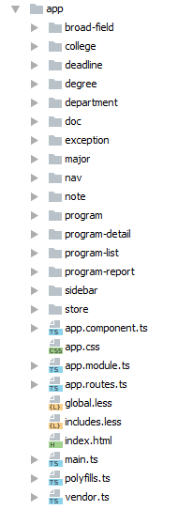
Front-end code organization
Source files grouped by category
They may contain:
Components
Services
Stores
Routes
Html
Css

Slide 10
Component Design
Definition: “part or element of a larger whole”
Isolate code responsibility for a piece of UI (html, js, css)
Each gets a tag name
Specific inputs and outputs
Components inside components - componentception!
gs-page-header
gs-search
gs-detail-nav
gs-app

Slide 11
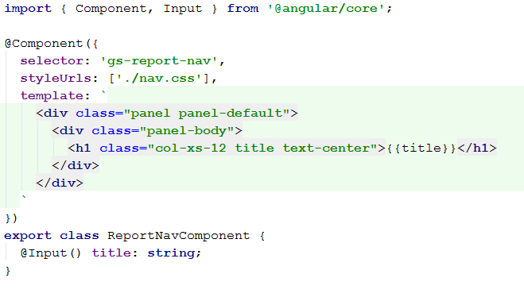
Component Design
What does a component look like inside?
How is it used?
Notes:
The right-hand side of the directive becomes an expression and you can even call a function or reference an instance variable to input the title.

Slide 12
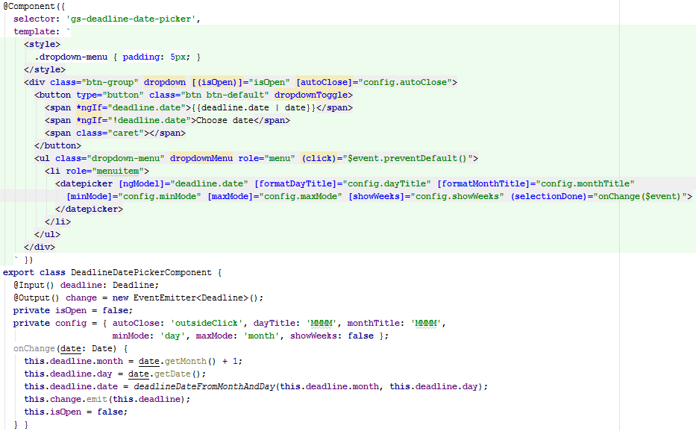
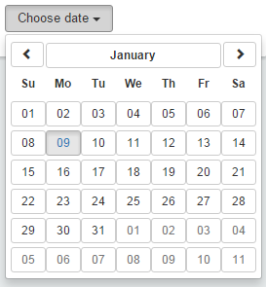
A more interesting one
Notes:
Two-way data binding (isOpen).
Outputs are represented by parentheses in the template. Again, the right side is an expression and you have a special variable called $event, which the tag passes using the output event emitter..
Sometimes 3rd-party ui libraries don’t do what you want, and you have to mess with them until you get it working right. isOpen is an example of this.

Slide 13
A more interesting one
Two-way data binding, input and output [ ( ) ]
Notes:
Two-way data binding (isOpen).
Outputs are represented by parentheses in the template. Again, the right side is an expression and you have a special variable called $event, which the tag passes using the output event emitter..
Sometimes 3rd-party ui libraries don’t do what you want, and you have to mess with them until you get it working right. isOpen is an example of this.

Slide 14
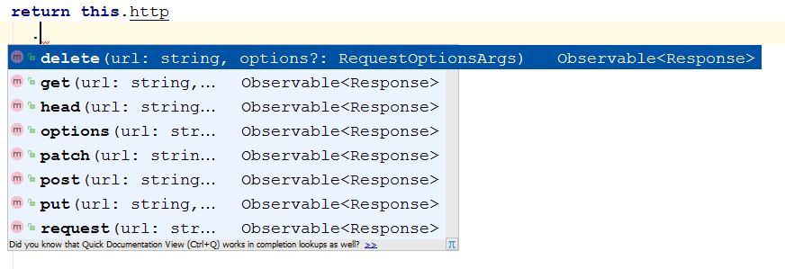
Tooling is pretty sweet
IntelliJ, VS Code, and Sublime have good code completion
IntelliJ will compile Typescript files for you!
Notes:
Java and .NET developers would be feel comfortable here. You can jump into typescript definitions and source code with little effort.

Slide 15
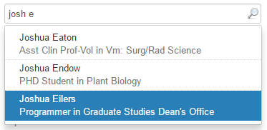
RxJS
Lodash for async
Mitigates nested callbacks
Powerful built-in operators
Built into Angular 2 http api
ES6 arrow function (callback)
Notes:
No timer handling, nested callbacks, or state tracking of each request.

Slide 16
Shared modules
Add the module to package.json dependencies
git tag
Point your current project to the shared module for local development
Make changes to your shared module, increment the version, and push it up
Update your project with the new version, other apps will still point to v1.1.30
Notes:
No timer handling, nested callbacks, or state tracking of each request.

Slide 17
Learning Angular2/RxJS
Egghead.io
Angular2 Quickstart

Slide 18
NPM Scripts
{
"name": "programs-manager",
"version": "1.0.0",
"description": "Web app for managing UC Davis Graduate Program information.",
"main": "./server/index.js",
"scripts": {
"dev": "set NODE_ENV=development&& set DEBUG=app:*,gs-core:* && npm run webpack:dev | nodemon --debug ./server/index.js",
"build": "rimraf client/dist && npm run webpack:prod",
"webpack:dev": "webpack --config webpack.dev.js --progress --watch",
"webpack:prod": "webpack --config webpack.prod.js --profile --bail",
"test": "set NODE_ENV=development&& jasmine DEBUG=app:*,gs-core:* JASMINE_CONFIG_PATH=jasmine.json",
"test:jenkins": "node jasmine-jenkins.js",
"start": "npm run migrate && node ./server/index.js",
"migrate:make": "set NODE_ENV=development&& knex migrate:make --knexfile server/db/knexfile.js",
"seed:make": "set NODE_ENV=development&& knex seed:make",
"seed": "node server/db/seed.js",
"migrate": "node server/db/migrate.js",
"rollback": "node server/db/rollback.js"
},
"repository": {
"type": "git",
"url": "git@bitbucket.org:gsucd/programs-manager.git"
},
"author": "UC Davis Graduate Studies",
"license": "ISC",
"homepage": "https://programs.gs.ucdavis.edu"
...
}

Slide 19
Why Node?
JavaScript/TypeScript on the server
Super simple web server and routing setup
Fast
One of the fastest growing ecosystems
Huge npm repository of open source libraries

Slide 20
ORM in Node
Why not NoSQL?
Not enough time to evaluate completely
Mongo DB is not managed by AWS requiring more sys admin work
AWS Dynamo DB has almost no npm modules and a tiny community
Not enough time for Postgres JSONB (next project though)
Why Postgres?
Open Source
Cheap
Managed by AWS
Good support for JavaScript
More robust, standard compliant and closer to Oracle syntax than MySQL
JSON query and indexing support
Why Bookshelf.js?
2nd biggest ORM
Allows dropping down to SQL since it is built on top of Knex.js
Knex had really good reviews

Slide 21
ORM and TypeScript
Bookshelf.js (and most ORMs) don’t work well with TypeScript
ES5 syntax
Runtime object and property generation
We built a custom ORM wrapper using TypeScript decorators
Inspired by Java Hibernate annotations
We want to publish this wrapper to npm, but haven’t had time
Advantages of Bookshelf.js
Promises instead of callbacks
Transaction support
Easy to read source code
Eager fetching for child objects
Debugging support for SQL statements
Migration and seeding support

Slide 22
TypeScript @Decorators
@Model()
export class DeadlineModel extends BaseModel<DeadlineModel> implements Deadline {
@Id() id: number;
@Prop() month: number;
@Prop() day: number;
@Virtual()
get date(): Date {
return deadlineDateFromMonthAndDay(this.month, this.day);
}
@BelongsTo('ProgramModel')
program: Program;
@BelongsTo('DeadlineTypeModel', { foreignKey: 'deadline_type' })
deadlineType: DeadlineType;
…
}

Slide 23
Class @Decorators
export function Model<T extends typeof BaseModel>(options?: ModelOptions) {
return (clazz: T) => {
BookshelfInstance['model'](clazz.name, clazz);
const tableNameProp = Object.getOwnPropertyDescriptor(clazz, 'tableName');
if (!tableNameProp) {
const tableName = ( options && options.tableName ) || clazz.name
.replace('Model', '')
.replace(snakeCaseRegExp, '$1_$2') // snake_case
.toLowerCase();
Object.defineProperty(clazz.prototype, 'tableName', { get: () => tableName });
}
if (!options || options.hasTimestamps) {
Object.defineProperty(clazz.prototype, 'hasTimestamps', { get: () => ['createdOn', 'lastModifiedOn'] });
}
if (clazz.prototype.propMetadata) {
clazz.prototype.propMetadata = _cloneDeep(clazz.prototype.propMetadata);
}
…
}
Class decorators get passed the constructor.
Method/property decorators get passed the prototype, property key and the property descriptor (eg getter/setter, enumerable, reference to property).
We are using the reflect-metadata module to get the TypeScript typing information.
Notes:
Typescript compiles the decorator down to wrapper functions around the class definition. Node calls the wrapper function just once and caches the result. The wrapper function is passed a reference to the class constructor which can be extended either directly for static methods or through the prototype for instance methods/properties.

Slide 24
Express
const app = express();
app.set('port', process.env.PORT || 3000);
app.set('views', path.join(__dirname, '../client/dist'));
app.set('view engine', 'html');
app.engine('html', hbs.__express);
...
config$.subscribe(
(config: Config) => {
...
app.use('/dist', express.static(path.join(__dirname, '/../client/dist')));
...
app.use('/', authRoutes);
app.use('/api/program', programApiRoutes);
...
app.use('/api/doc', docApiRoutes);
app.use('/api/note', noteApiRoutes);
app.use('/api/error', errorApiRoutes);
app.use('/api/system', systemApiRoutes);
...
app.use('/', (req, res) => {
res.render('index', {
token: res.locals['user'] && res.locals['user'].token,
userPref: JSON.stringify(userPref),
config: JSON.stringify(config.clientConfig)
});
});
http
.createServer(app)
.listen(app.get('port'), () => {
console.info('Express listening on port %s in %s mode', app.get('port'), app.get('env'));
});
},
err => console.error(err)
);
Notes:
The easiest part of the app. Config$ combines an async call to from s3 for passwords with the local config settings.

Slide 25
JWT in Express
router.use('/api', authenticateToken);
router.get('/auth/post-login', validateCasTicket, loadUserDetailsFromCas);
...
const authenticateToken = (req: express.Request, res: express.Response, next: express.NextFunction) => {
const token = req.headers[config.auth.tokenName.toLowerCase()];
...
services
.jwtService
.deserialize(token)
.subscribe(currentUser => {
res.locals['user'] = currentUser;
res.locals['user'].token = token;
},
err => next(err),
() => next()
);
};
const loadUserDetailsFromCas = (req: express.Request, res: express.Response, next: express.NextFunction) => {
// If the CAS ticket was validated, find the user details from PRM and set the JWT
if (session && session.cas && session.cas.user) {
...
// Call People & Role Manager (PRM) to get user details
currentUserService
.findByUsernameOrId(session.cas.user)
.flatMap((currentUser: Person) => {
res.locals['user'] = _cloneDeep(currentUser);
})
...
// Serialize user details into JWT
res.locals['user'].token = token;
// Set SSO cookie so the front end knows the user has hit CAS
res.cookie('sso', 'cas', cookieOptions);
}
}
Notes:
Completely stateless app. JWT contains user name, login ID and email. Permissions are checked on every request that is sensitive.

Slide 26
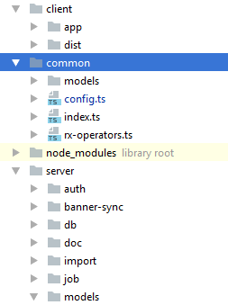
Client / Server Code Sharing
Client side code lives in client/app/
Common TypeScript interfaces live in common/
Server side code lives in server/
common/ also contains some shared sorting and validation code

Slide 27
Client / Server Code Sharing
export class AppConfig implements Config {
appName: string;
appUrl: string;
...
get clientConfig(): CommonConfig {
return {
env: this.env,
shortEnv: this.shortEnv,
appName: this.appName,
appUrl: this.appUrl,
appId: this.appId,
auth: {
tokenName: this.auth.tokenName,
loginUrl: this.auth.loginUrl
},
prmUrl: this.prmUrl,
};
}
...
}
import { AuthConfig } from 'gs-core/common/config';
export class CommonConfig {
appName: string;
appUrl: string;
appId: number;
env: string;
shortEnv: string;
auth: AuthConfig;
prmUrl: string;
}

Slide 28
TypeScript Interfaces
Shared Interface and Sorter
export interface Deadline extends BaseEntity {
id: number;
deadlineType: DeadlineType;
month: number;
day: number;
date: Date;
}
export const deadlineComparator = (deadline: Deadline) => {
return deadline.deadlineType.sortOrder;
};
...
Server Side Use
@Model()
export class DeadlineModel extends BaseModel<DeadlineModel> implements Deadline {
@Id() id: number;
@Prop() month: number;
@Prop() day: number;
...
@Model()
export class ProgramModel extends BaseModel<ProgramModel> implements Program {
...
@HasMany('DeadlineModel', { destroyOrphans: true, comparator: deadlineComparator })
deadlines: Deadline[];
...
}

Slide 29
TypeScript Interfaces
Client Side Use
import { Deadline } from '../../../../common/models/index';
@Component({
selector: 'gs-deadlines',
template:
})
export class DeadlinesComponent implements OnInit {
private newDeadline: Deadline = this.buildNewDeadline();
...
buildNewDeadline(): Deadline {
return {
id: null,
deadlineType: null,
month: null,
day: null,
date: null
};
}
removeDeadline(deadline: Deadline) {
...
}
addDeadline() {
...
}
}

Slide 30
Why AWS?
Cost
Control
Changes right when we need them
Downtime
High-availability (at a price)
Features
S3
Load Balancers
Blue/Green deployment

Slide 31
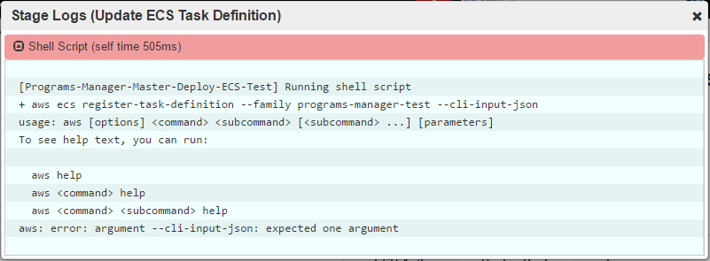
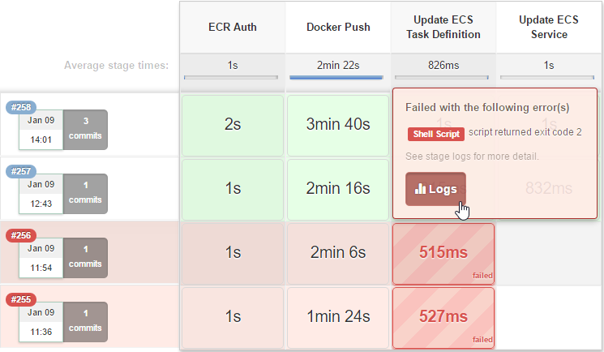
Jenkins Pipeline
Build Process as code
In application repo
Separate build stages for troubleshooting
Test
Jenkins
Pipeline

Slide 32
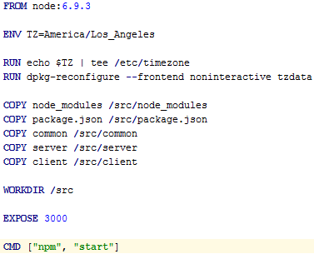
Docker
Build Process as code
In application repo
PaaS on AWS
Many small applications
Too small for Elastic Beanstalk
Easy version upgrades
Test
Build
Jenkins
Pipeline

Slide 33
ECS (Elastic Container Service)
Container management service
Self-healing
Blue/Green deployment
Built-in
Test
Build
Deploy
Jenkins
Pipeline
ECS

Slide 34
S3
(Simple Storage Service)
RESTful file storage / retrieval
Access controls
Encrypted in transit, encrypted at rest
$0.023 / GB / month
2015/16 admissions season ~70,000 pdfs
On-campus edms: $15,000/yr
AWS: < $20
DB Credentials
Test
Build
Deploy
S3
Jenkins
Pipeline
ECS

Slide 35
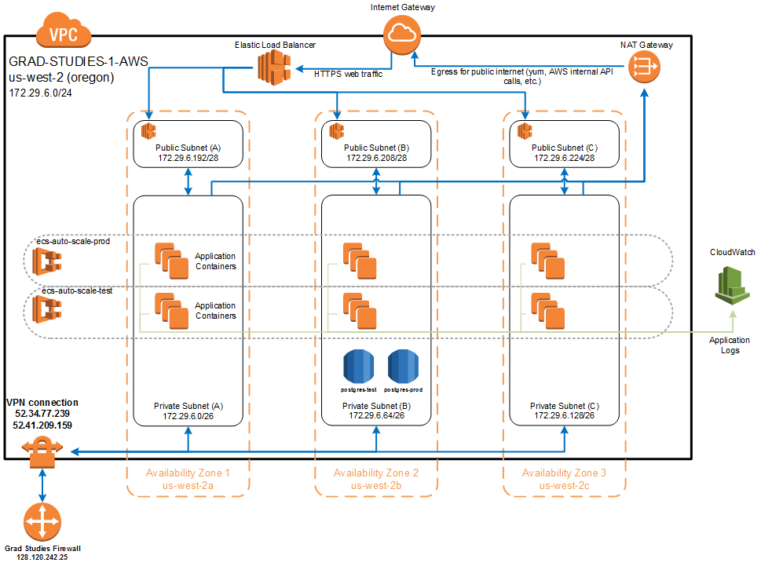
Terraform
Infrastructure as code
In BitBucket
Declarative
Easier than Cloud Formation

Slide 36
Pain Points
Angular 2 in Beta and RC
Lots of deprecated features between Beta and rc4
Lot of changes to Router, Form builder and NgModule
3rd party modules not able to keep up: ng2-bootstrap
Multiple ways to do things
template: `<style>` or styles: [ ] or styleUrls: [ ]
Vague error messages caused by zones.js wrapping most browser actions
Slow development waiting for TypeScript to compile
SystemJS (Angular 2 script loader)
Obscure error messages when the module is not found
We moved to WebPack
RxJS
Confusing documentation as the API changed a lot between 4.0 and 5.0
Complexity; lots of vague and redundant method names
Functional programming concepts

Slide 37
Pain Points … continued
TypeScript
Typing files moved from tsd to typings to @types (3rd party libraries)
Line endings (\n vs \n\r)
Split target JavaScript version; client => ES5, node => ES6
Shared common/ folder constantly recompiled (ES5, ES6, ES5 …)
SOA / Microservices
Performance when one resource is in AWS Oregon and one in Davis
Rolling back database if one of the follow up http POST fails (still a work in progress)
Handling networking hiccups
Immature ORMs for Node
Bookshelf.js is good for querying, not so good for saving
No cascade save; have to manage saving child objects manually
Limited documentation
ORM and TypeScript/ES6
Most ORMs dynamically generate models and property which do not work well with TypeScript and ES6

Slide 38
Pain Points … and more
Error handling in Node
Errors swallowed by Promises or Observables (RxJS)
Remembering to pass errors to Express next()
JWT
New tab or window forces a new JWT
Node Single Thread
setTimeout / setInterval prevent Node from exiting correctly
AWS
Huge learning curve
Default timezone for EC2 and Docker is UTC

Slide 39
Improvements
Learning and using tooling
Less console.log and more debugging
IntelliJ or Chrome Node Inspector
Re-evaluate 3rd party modules
ngrx/store (Redux pattern)
ng-bootstrap instead of ng2-bootstrap
Postgres JSONB with MassiveJS
Angular CLI instead of Webpack
Improve AWS error logging and alerts
Transactions across microservices
Scheduled jobs across multiple instances

Slide 40
Why Not React?
At the time (beginning of 2016)
Smaller feature set
UI only. No opinion on structuring services, http, ...
Supporting frameworks and tooling were still in flux
Redux wasn’t the de-facto standard yet
We had to pick one
We did a brief training on React and decided to pilot test Angular 2
Large Angular 1 ecosystem is more likely(?) to move to Angular 2
More StackOverflow answers
More Angular modules
Better tooling
Looking back was it a good decision?
The jury is still out! Angular 2 works well, but React has only gotten bigger
Notes:
React has one potential advantage in that its templating is done closer to JS. Angular has a domain-specific syntax to its templates.

Slide 41
Why Single Page App?
More responsive UI and better UX with less code
Complete separation of client and server code
Separation of Concerns
Cleaner code organization
Server is strictly an API endpoint allowing reuse by other servers
Our public website and role manager are using the same API endpoint
The only server-rendered html is the index file - JS is in the driver seat
We think it’s pretty cool!
Notes:
You can think of what is inside of the browser as a self-contained app. The server layer can be implemented using technology of choice. Starting out is really nice because you don’t even need a server to build your app, ie: in-memory web api.

Slide 42
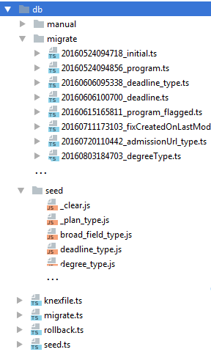
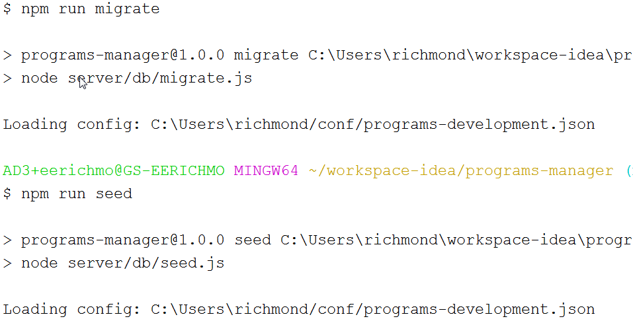
Database Migration & Seeding

Slide 43
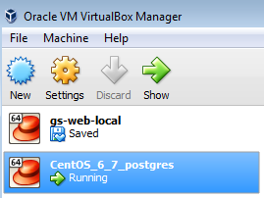
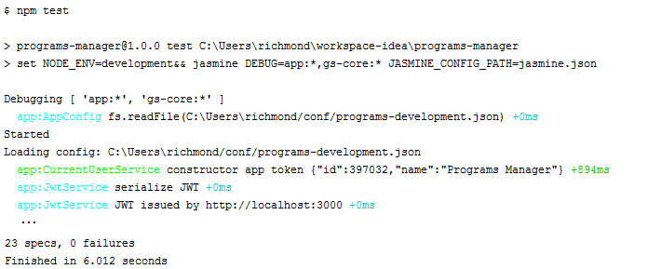
Local Dev
Local Postgres in VirtualBox
Quick offline local development
Repeatable db integration tests
Re-seed before each integration test
App runs on localhost:3000

Slide 44
TypeScript @Decorators
export class BaseModel<T extends BaseModel<T>> extends BookshelfInstance.Model<T> implements Bookshelf.Model<T>, BaseEntity {
@Prop() createdOn: Date;
@Prop() lastModifiedOn: Date;
propMetadata: { [ name: string ]: PropMetadata };
constructor(args?, options?: ModelOptions) { super(args, options); }
…
}

Slide 45
Property @Decorators
export function Prop() {
return (clazzPrototype, propName: string) => {
const propType = Reflect.getMetadata('design:type', clazzPrototype, propName);
if (!clazzPrototype.hasOwnProperty('propMetadata')) {
clazzPrototype.propMetadata = _cloneDeep(clazzPrototype.propMetadata) || { };
}
clazzPrototype.propMetadata[propName] = clazzPrototype.propMetadata[propName] || { };
clazzPrototype.propMetadata[propName].type = propType;
Object.defineProperty(clazzPrototype, propName, {
get: function() { return this.get(propName); },
set: function(value: any) { return this.set(propName, value); }
});
};
}
Method/property decorators get passed the prototype, property key and the property descriptor (eg getter/setter, enumerable, reference to property).
We are using the reflect-metadata module to get the TypeScript typing information.

